Slide 1
POVs and Experience Prototypes
Esther Goldstein, Ron Tep, and Rachel Jorgensen

Slide 2


Team 4:
Esther Goldstein
1st year MS in CS
Ronald Tep
Senior in CS
Rachel Jorgensen
Senior in SymSys

Slide 3
Problem Domain
How can we make voice interaction more accessible for people in their day-to-day lives?

Slide 4
Initial POV
We met Allen, a police officer in SFPD.
We were amazed to realize that his police department often can’t find a translator for weeks, even when on important cases.
It would be game-changing to reduce the response time for getting translations by using voice interaction.

Slide 5
Additional Needfinding Results

Slide 6
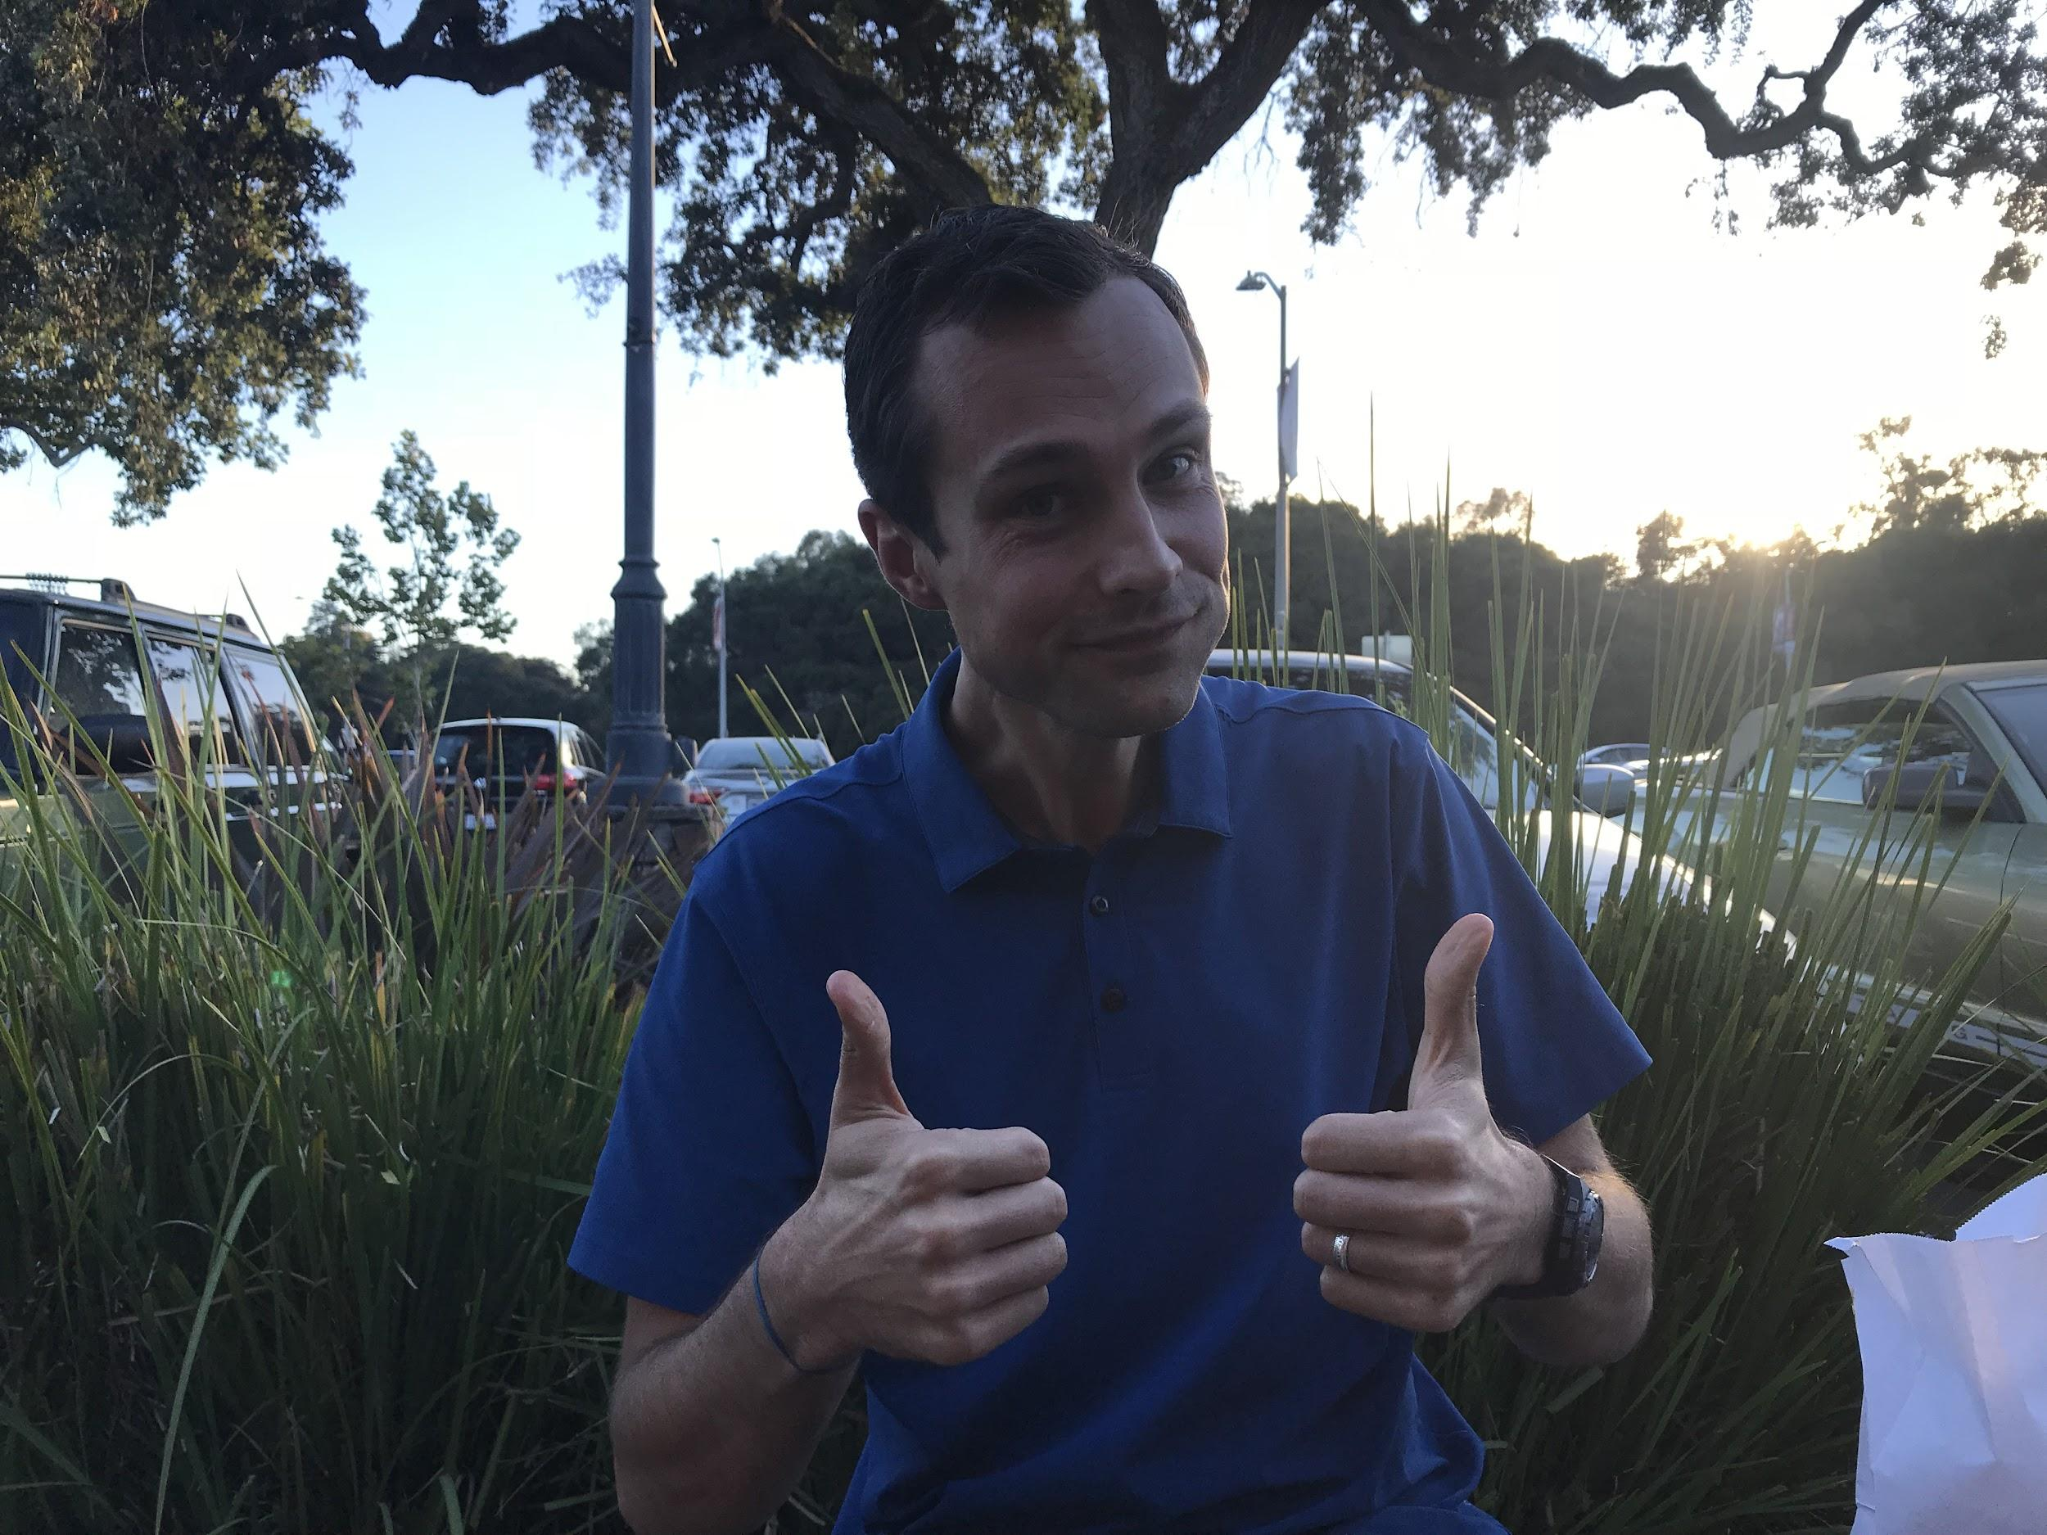
We Met...
Hunter, a business operations employee for a solar company
Has two Alexas and uses Siri
Experiments with commands but gets frustrated if they’re not intuitive

Slide 7
I bought a smart fan and thought I could say “Alexa, turn on fan,” but apparently it was called Dyson. Who knew?
- Hunter

Slide 8
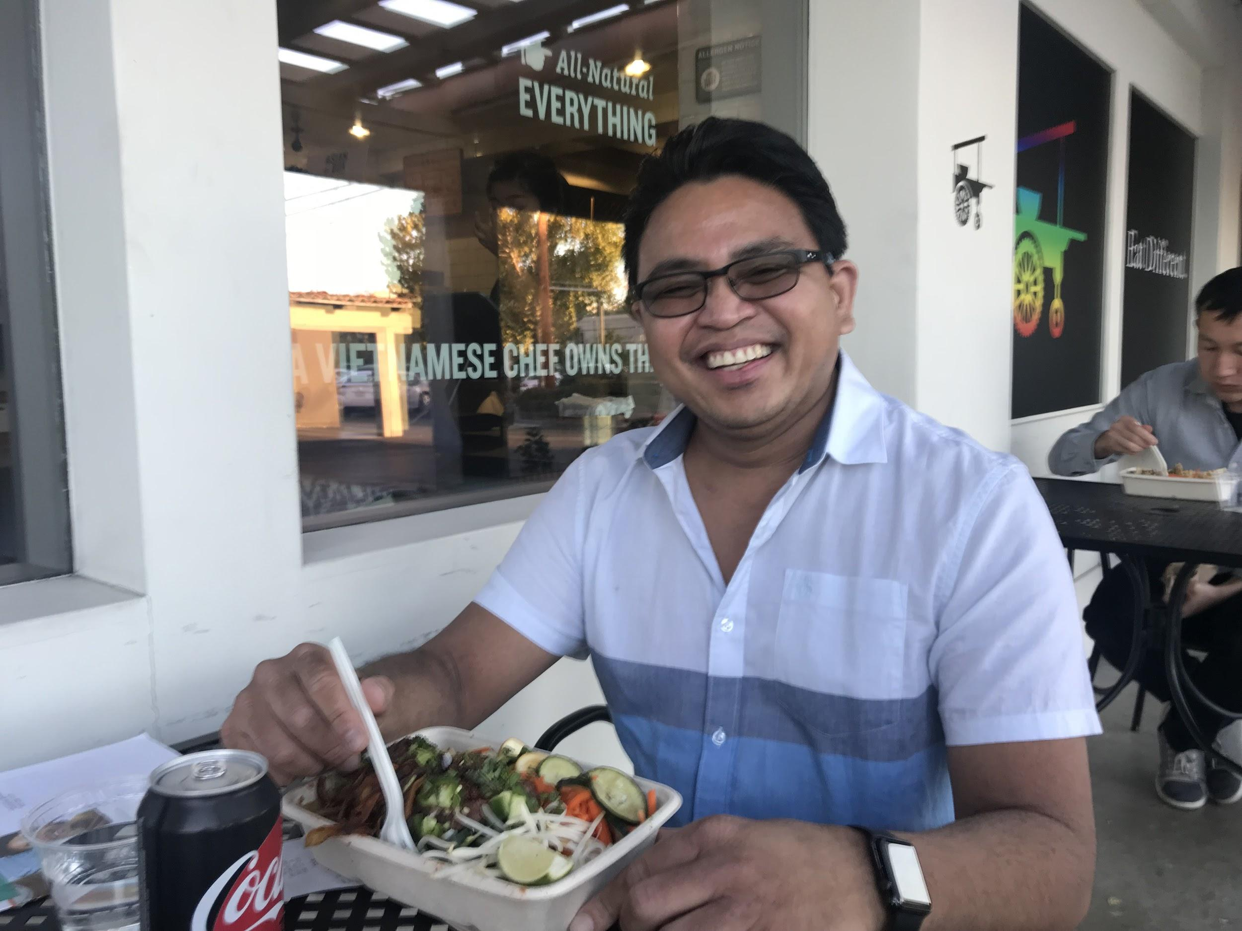
We Met...
Edwin, a Registered Nurse at Sequoia Hospital
Uses Voicera at work to contact his team
Gives daily reports to transcriptionists

Slide 9
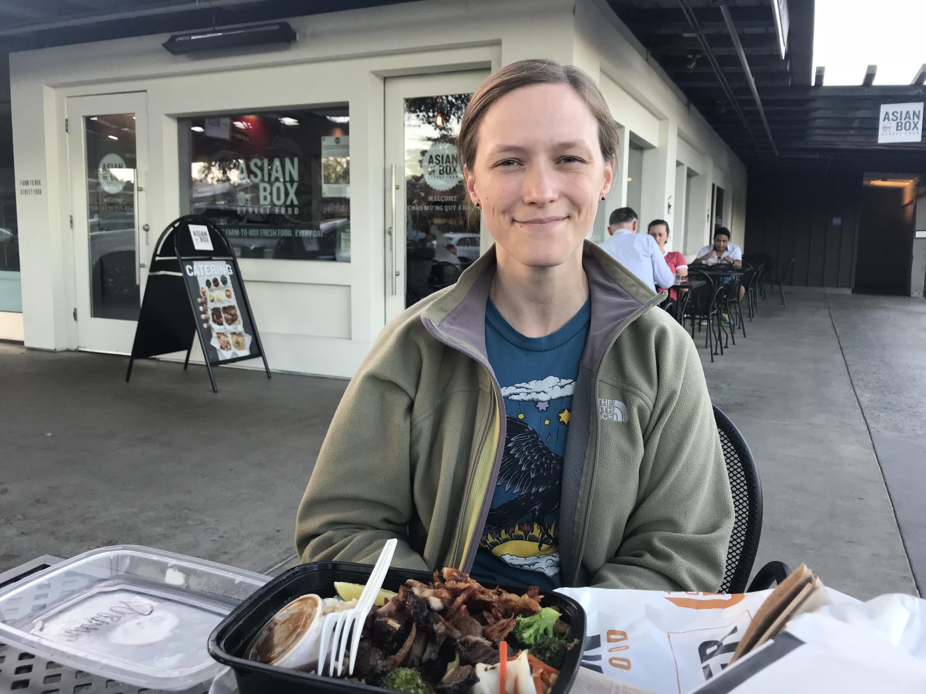
We Met...
Therice, a PhD student in Electrical Engineering
Doesn’t feel the need to use VI
Too many clicks to create an event in Google Calendar

Slide 10
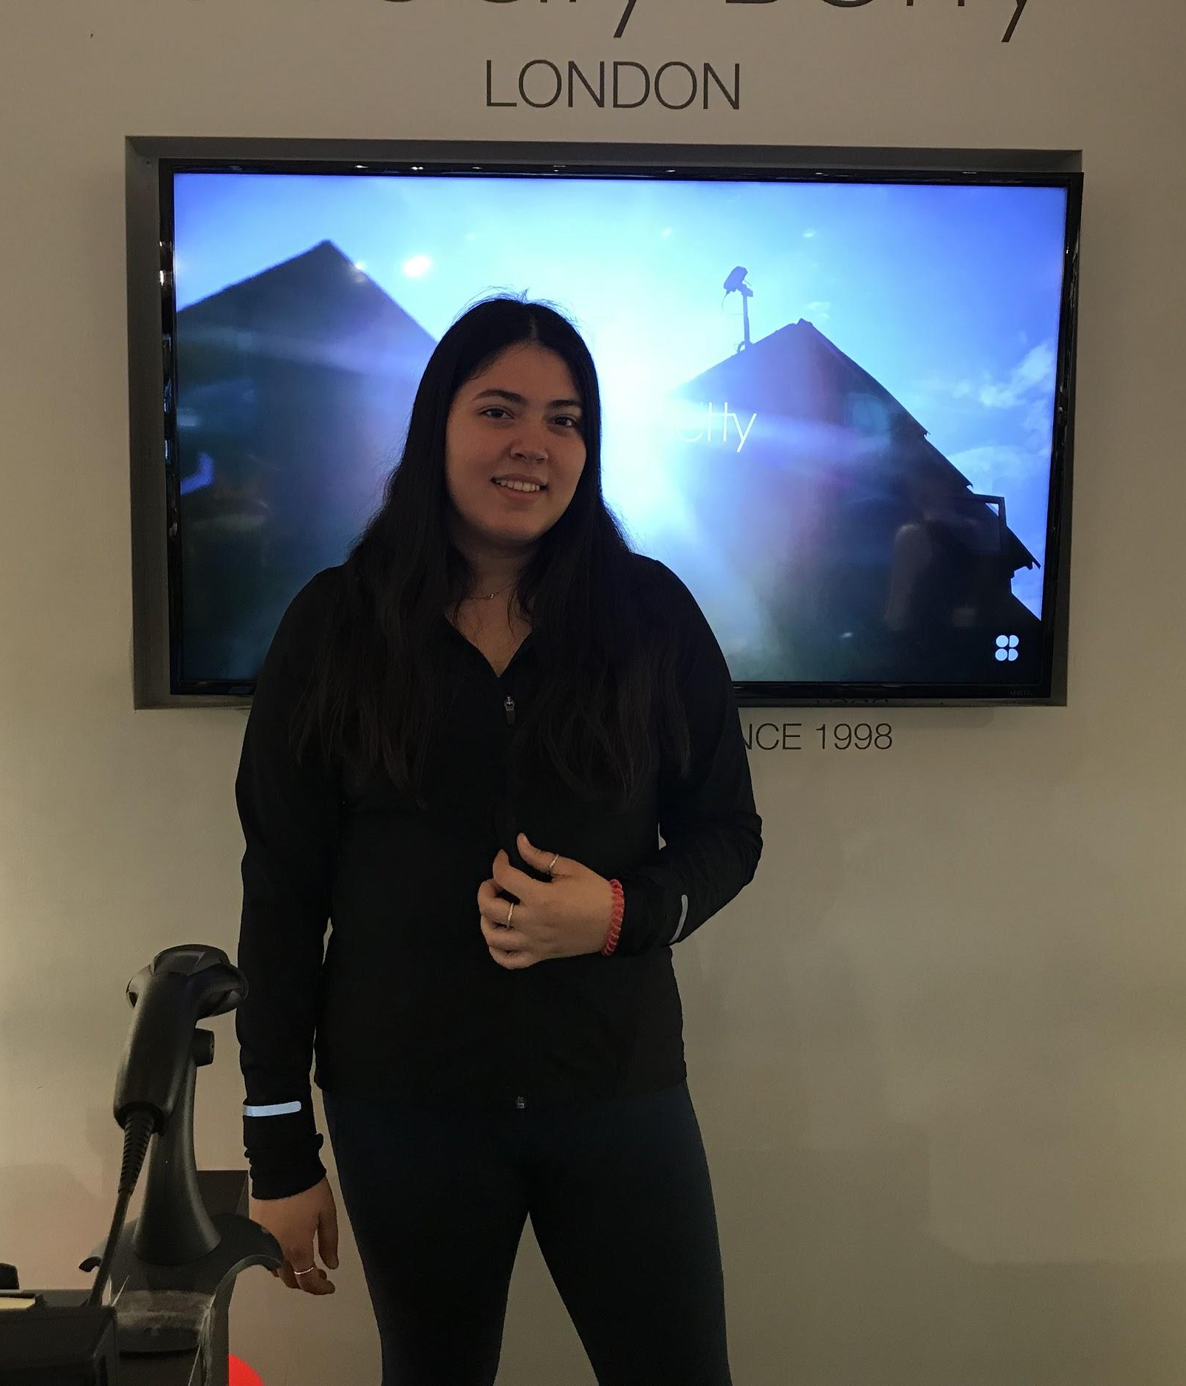
We Met...
Caroline, a shopkeeper at Sweaty Betty
Has to write down her sales goal for the day and manually calculate remainder
Thinks voice assistants are for busy people who need it to keep up with their workload

Slide 11

Revised POVs

Slide 12
#1
We met Hunter, a business operations employee at a solar company.
We were amazed to realize that some voice commands are not intuitive.
It would be game-changing to allow users to be more flexible by defining their own commands that will map to existing VI commands.

Slide 13
How Might We...
Make talking to VI software more like talking to a real person?

Slide 14
Possible Solution:
Provide a means to make up your own commands when interacting with voice assistants.

Slide 15
#2
We met Naina, an international first-year Master of Laws student.
We were amazed to realize how intimidating and obscure the American healthcare system can be.
It would be game-changing to provide a means to more easily understand this complicated system.

Slide 16
How Might We...
Present healthcare or health insurance information in a more digestible way?

Slide 17
Possible Solution
Create a VI assistant app to answer questions about healthcare and present information in an easily digestible way.

Slide 18
#3
We met Caroline, a storekeeper at Sweaty Betty.
We were amazed to realize that most of her job involves boring, menial tasks.
It would be game-changing to reduce the boredom in regards to taking inventory and waiting for customers to arrive in retail worker jobs

Slide 19
How Might We...
Bridge the gap between writing down inventory and typing it into a computer?

Slide 20
Possible Solution
Create a VI assistant that can help take inventory and reduce the time to enter items into an inventory system.

Slide 21
Experience
Prototypes

Slide 22
Prototype 1
Mobile App:
View/edit smart devices to device list
Add/edit custom commands that map to existing ones
Share device list with visitors

Slide 23
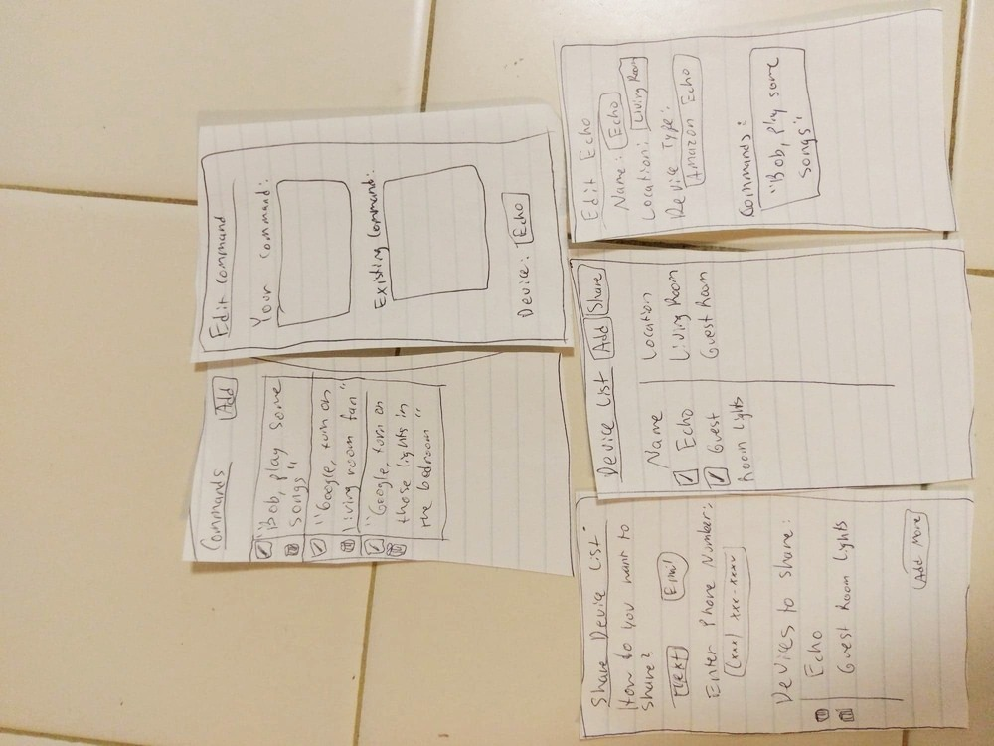

Slide 24
Arjun at Tressider:
Liked small set of features
Not sure how to implement mapping
Possibly limited user base

Slide 25
Assumption:
Own smart devices and/or voice assistants
Want to be flexible in how they interact with them
However...
Not everyone owns devices or cares to be flexible
Need users that want control

Slide 26
Prototype 2
Each screen is a voice assistant screen
Search for answers regarding healthcare
Schedule a doctor’s appointment
Report simple information on school or company’s health plan

Slide 27
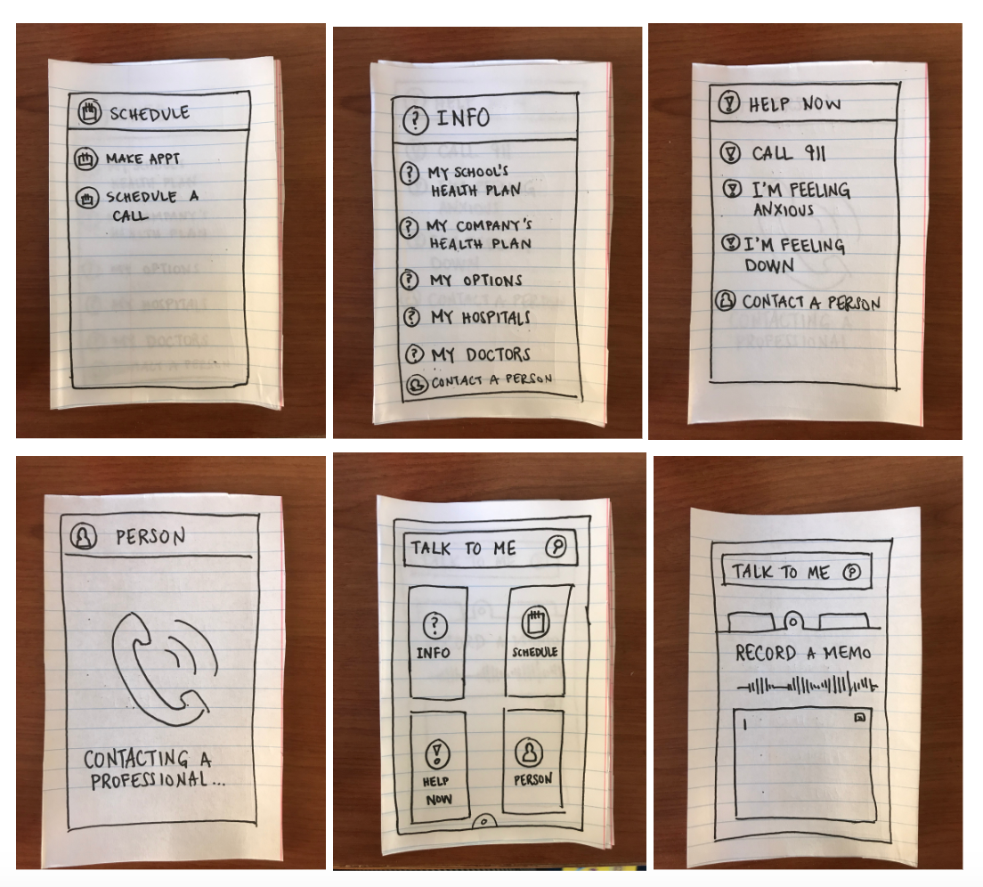

Slide 28
Jackson at Tressider:
Who gets contacted in an emergency?
Need to make sure app offers a unique benefit

Slide 29
Assumption:
Want information about healthcare just by asking verbal questions
...Confirmed!
Agreed healthcare information can be confusing
Helpful to speak to app and receive guidance

Slide 30
Prototype 3
Remove the need to switch between a notepad and online inventory software
Prompts user for item name and quantity
Presents spreadsheet containing values

Slide 31
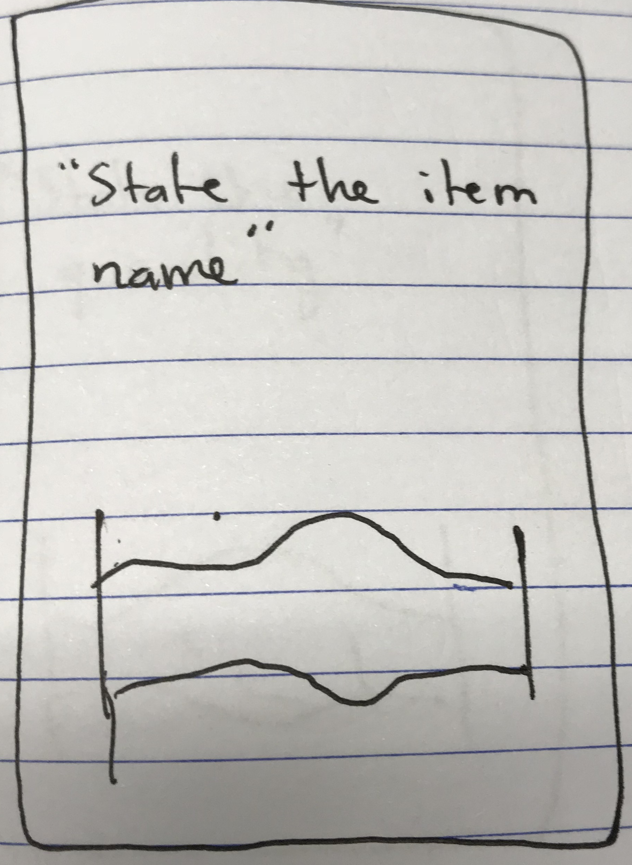
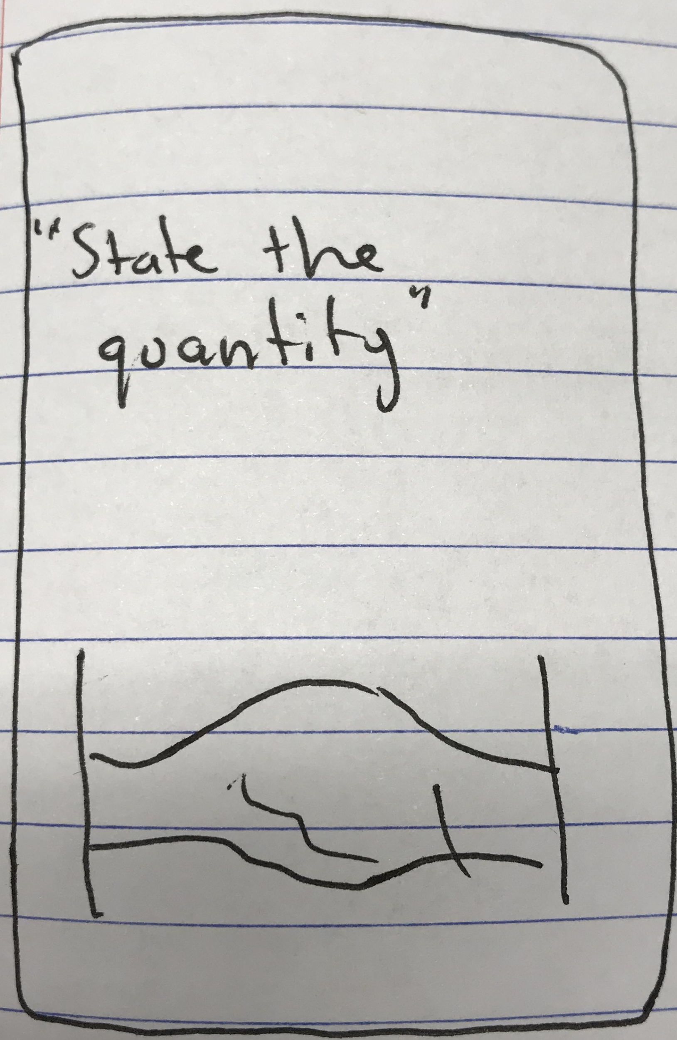
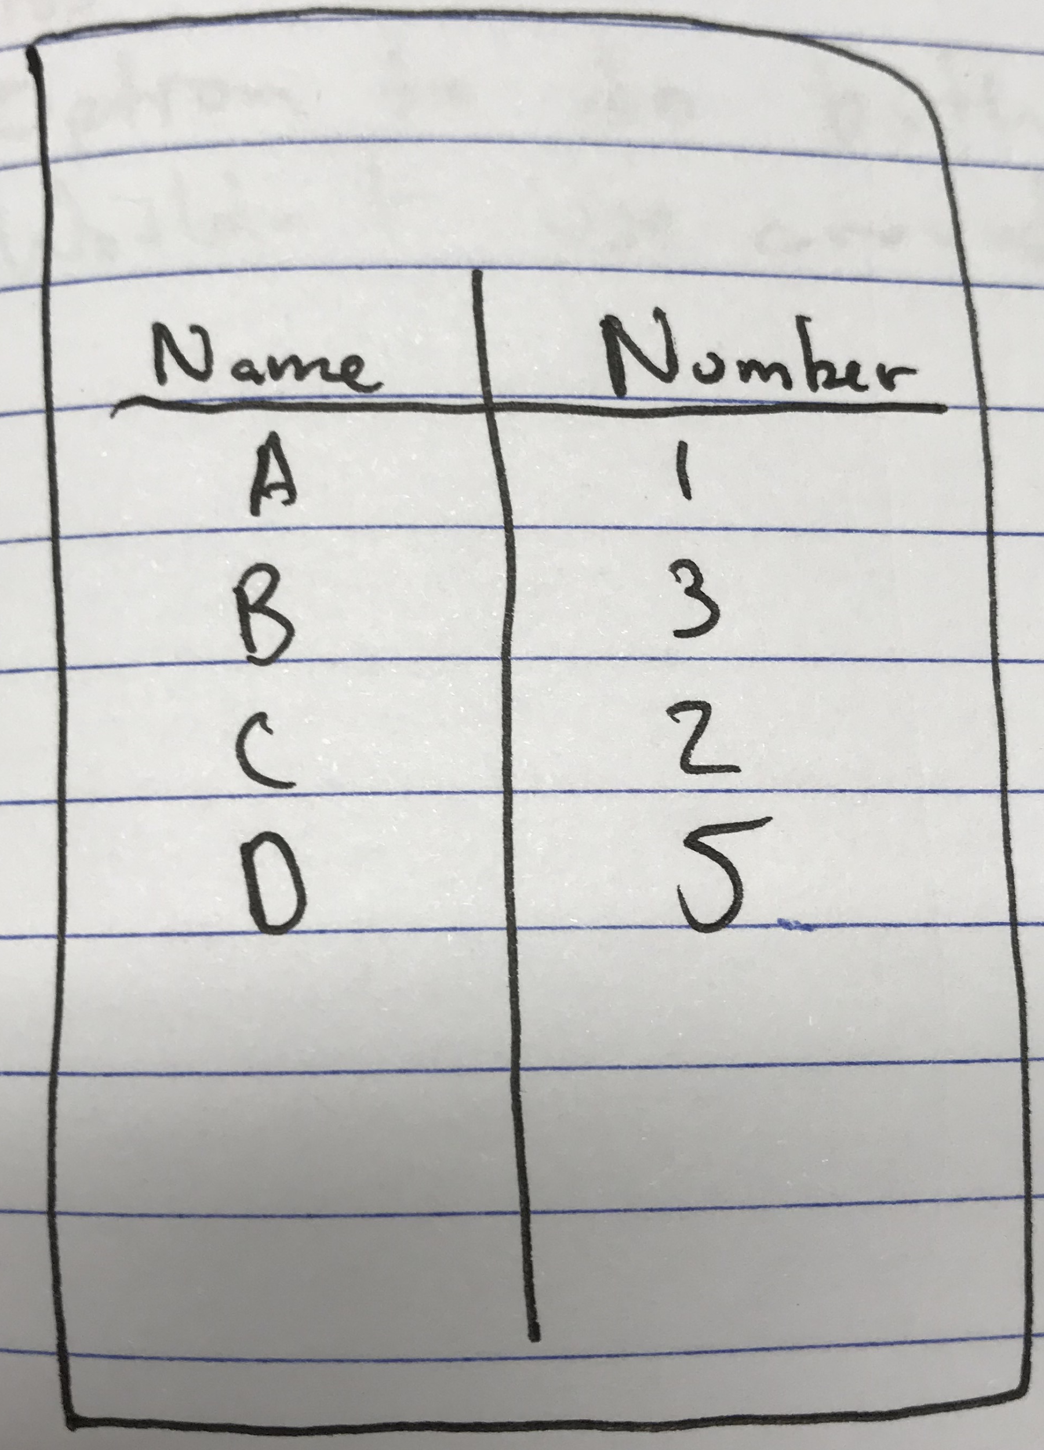

Slide 32
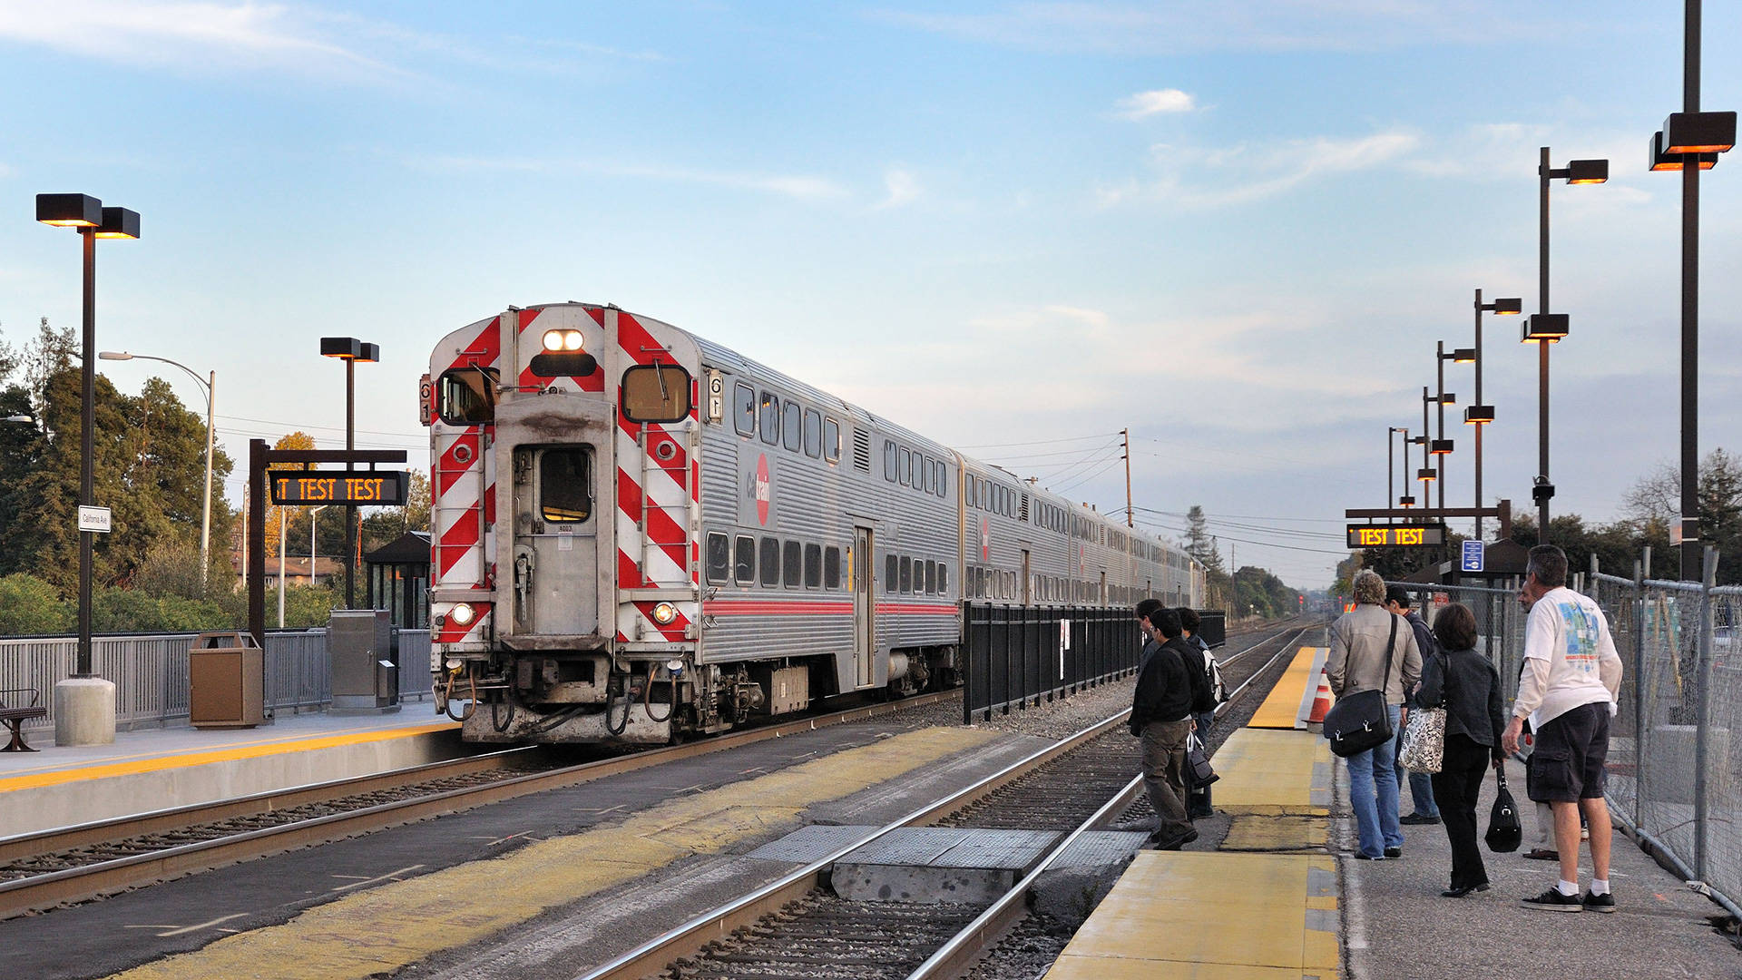
Shannon at Caltrain station:
Wants to ensure there you can edit the entries
Prefers auditory interactions but likes option to visually interact or use touch

Slide 33
Assumption:
Retail workers want a way to reduce the effort of writing and typing inventory information each day
...Questioned?
Concerned with error rate of app’s translation
Inventory key in profit; little room for error

Slide 34
Summary

Slide 35
Winner: flexible voice commands
Arjun was interested in the future prospects of the app, even though he doesn’t use smart devices.
Goal: Transform interaction with voice assistants into a more pleasurable experience
How? Interact with their devices in desired manner, and keep track of all devices

Slide 36
Questions?

Slide 37
Credits
Special thanks to all the people who made and released these awesome resources for free:
Busy Icons by Olly Holovchenko
Presentation template by SlidesCarnival
Photographs by Unsplash
Backgrounds by Pixeden

